Slide 1

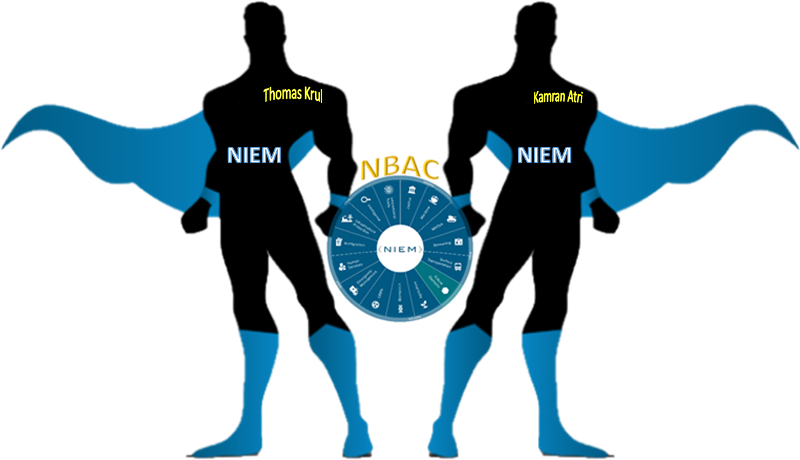

NIEM NBAC F2F 2021
Session VI – Sharing & Collaboration

Slide 2
Session VI – sharing & Collaboration

Slide 3







HOUSEKEEPING:
MUTE your mic when you’re not talking
Identify yourself before you start to speak
Speak clearly
Disable “call waiting” feature (the clicking noise can be heard by all)
Please note: All 2021 sessions are audio recorded for NIEM training & communications purposes
QUESTIONS & ANSWERS ARE ENCOURAGED!
To signal you want to contribute without interrupting the speaker
Enter comments via CHAT window at any time
To signal a question or respond to a question
Click on ‘Raise your hand’ button on meeting toolbar
(Lower hand after you’ve talked by clicking hand button again)
All session briefings are available on NIEM’s GitHub for download as they occur
Session Speakers
Primary Facilitator
Kamran Atri
Primary Facilitator
Thomas Krul
PMO Managing Director
Katherine Escobar
Primary Facilitator
Stephen M.Sullivan
https://github.com/NIEM/NIEM-Annual-Meetings/tree/master/2021

Slide 4
Reminder:
Every NBAC member shares and is part of NIEM decision-making process.
We will seek consensus for decisions arising from the NBAC F2F 2021.
The TEAMS meeting (s) will be recorded, action items assigned, and decisions implemented.
We plan to adhere to the topics and schedule as outlined in the Agenda.
Don’t be shy, speak up when you have something to say.
Ask questions if you are unclear or unsure… share your views.
Expand your professional network here with your fellow data standards gurus.

Slide 5
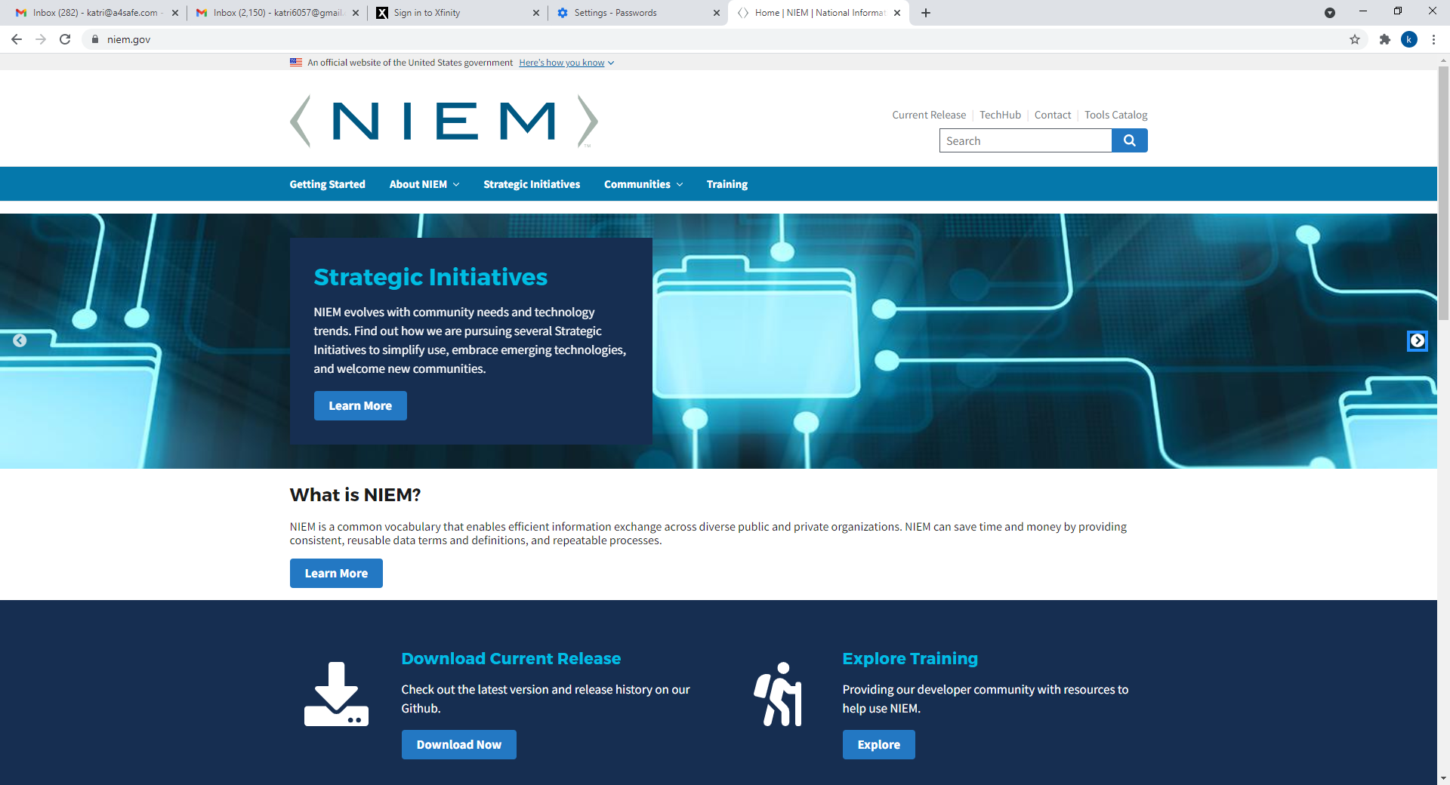
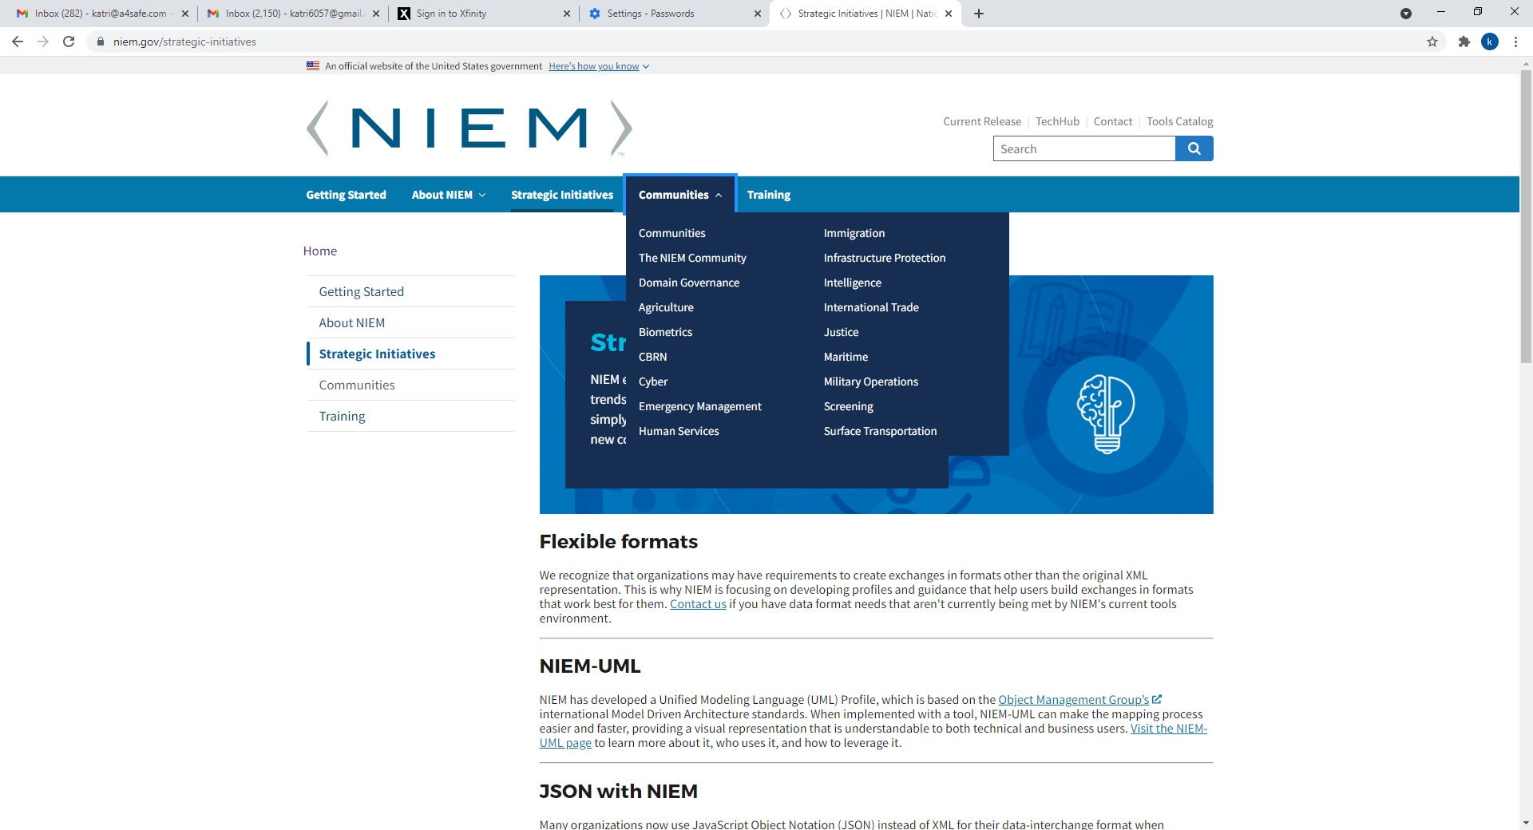


Enhanced NIEM.GOV Demo
NIEM IEPD
Repository

Slide 6

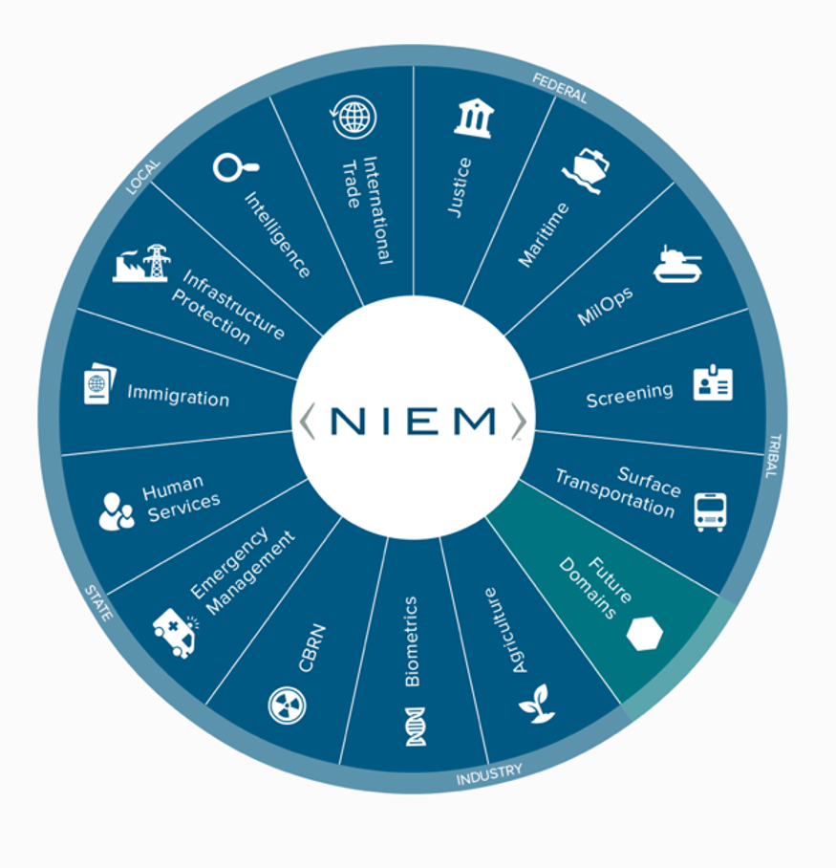
from Domains
From Domains

Slide 7
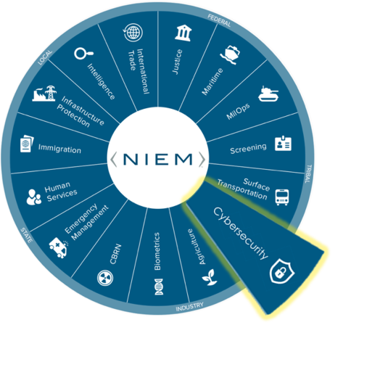
NBAC Annual Meeting
Cyber
DOMAIN UPDATES

Slide 8

Cyber Domain Update
Domain Steward & Stakeholders: Juan Gonzalez (Domain Representative) on behalf of Brian Gattoni (Domain Steward)
Description
2021 Highlights: Newly developed content to be included as part of NIEM 5.1 Release. 2022 Objectives: IEPD development and community engagement. NIEM Recommendations:
2021 Highlights
2022 Objectives
NIEM Recommendations
Developed new content to be included as part of the NIEM 5.1 Release for the following:
Federal Incident Reporting content developed by MITRE and in collaboration with CISA and GTRI.
State, Local, Tribal and Territorial (SLTT) Cyber Incident Reporting content developed by the Cybercrime Support Network (CSN) and in collaboration with CISA and GTRI.
Continue community engagement.
Plan for a Cyber Domain Symposium in December.
Message Exchange Package development for incident reporting for Federal and SLTT exchanges.
Piloting of IEPD(s) developed at the Federal and/or SLTT levels.
Strong community engagement for usage and implementation of newly released content.
Insert Bullets Here

Slide 9
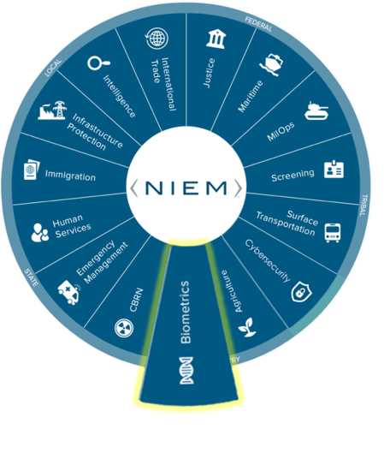
NBAC Annual Meeting
Biometrics
DOMAIN UPDATES

Slide 10

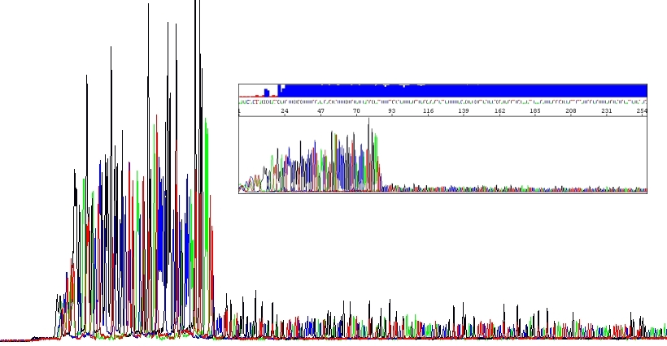
“Biometrics” Domain Update
Domain Steward & Stakeholders: (AD John M Boyd - Chair Biometrics Domain/DHS OBIM)
Mature the Domain:
The NIEM Biometric Domain (NBD) Team at OBIM led bi-weekly NIEM Biometric Domain Working Group (NBDWG) meetings where DNA SME’s, NIST, & the NBD Executive Committee (NBDEC – DHS, DoD, DOJ, & NIST) to expand DNA related attributes.
Additional DNA attributes were added to the NIEM 5.1 Biometrics Domain release.
2021 Highlights
Open-Source Project:
The NBD Team is working with the DNA Store Match Share team, on a DNA Open-Source Project to replace the 16-bit integer field with a 32-bit integer field by producing a new file format, .fsax. The need was identified in the HLT NBDWG meetings.
We stood up a GitHub Repository for this effort, which will enable peak heights to be expressed as the maximum of a 32-bit integer (2.14 billion).
2022 Objectives
We would like to know if there are any other agencies working on maturing the DNA standard.
Recommendations

Slide 11

“Biometrics” Domain Update
Domain Steward & Stakeholders: (AD John M Boyd - Chair Biometrics Domain/DHS OBIM)
We held NBDWG meetings for identification of voice related attributes to support OBIM’s Human Language Technology (HLT) initiative.
We performed a NIEM, NIST, and Open Language Interface for Voice Exploitation (OLIVE) Software standards gap analysis to as part of the NBDWG HLT effort. OLIVE is being utilized by OBIM in their HLT pilot.
This effort is to identify possible attributes for NIST & NIEM updates (5.2 release) to mature HLT in the NBD domain.
2021 Highlights
We would like to know if there are any other agencies working on voice as a biometric modality, so we gather broader use cases to factor into the NBDWG discussions.
2022 Objectives
The “way ahead” for the Biometrics Domain will be to advance the NIEM model for HLT/Voice & collaborate with NIEM on the NIEM Biometrics Domain 5.2 release.
Recommendations

Slide 12
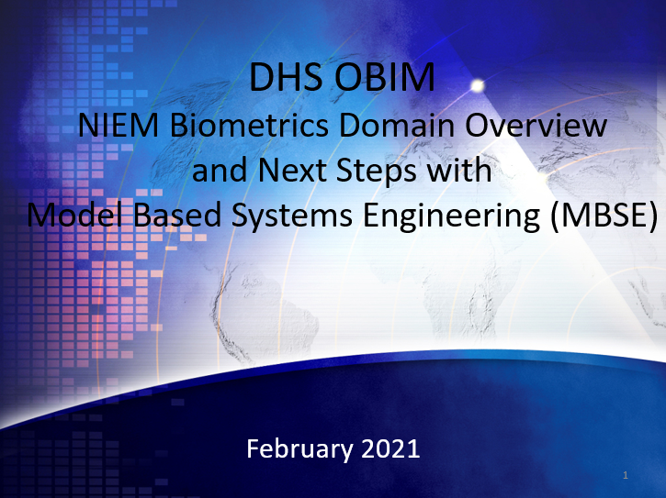
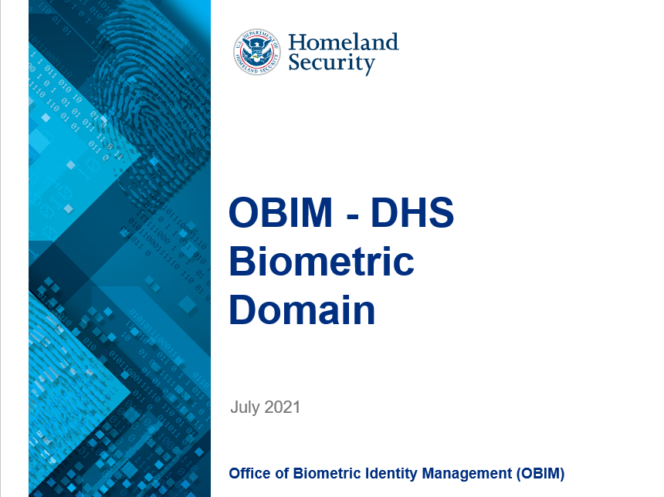
“Biometrics” Domain Update
We Promote NIEM!
Domain Steward & Stakeholders: (AD John M Boyd - Chair Biometrics Domain/DHS OBIM)
Activities for 2021 include, but are not limited to, the briefings which we provided to promote NIEM adoption for the below agencies and groups:
The DHS Office of the Chief Information Officer (OCIO) Chief Data Officer & team
The Data Stewardship Tactical Working Group (DSTWG) Immigration Technology Summit
DHS Management’s Mission Support & Management Domain (MSMD) briefing is scheduled
2021 Highlights
We support the NTAC & NBAC, Tiger Teams, and we review technical specifications related to NIEM, e.g. Metamodel Primer.
The NBD Team will continue to promote & support NIEM through briefings, outreach, NBDWG sessions, NBAC, NTAC, & Tiger Teams, Newsletters, and more.
The NBD Team will continue contributing to the NTAC as a member.
2022 Objectives
Please let us know if you have any feedback or recommendations.
Recommendations

Slide 13
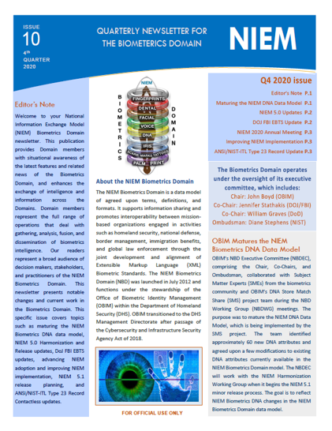
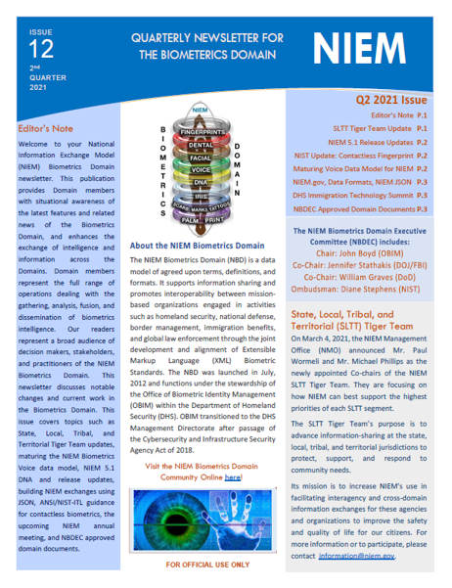
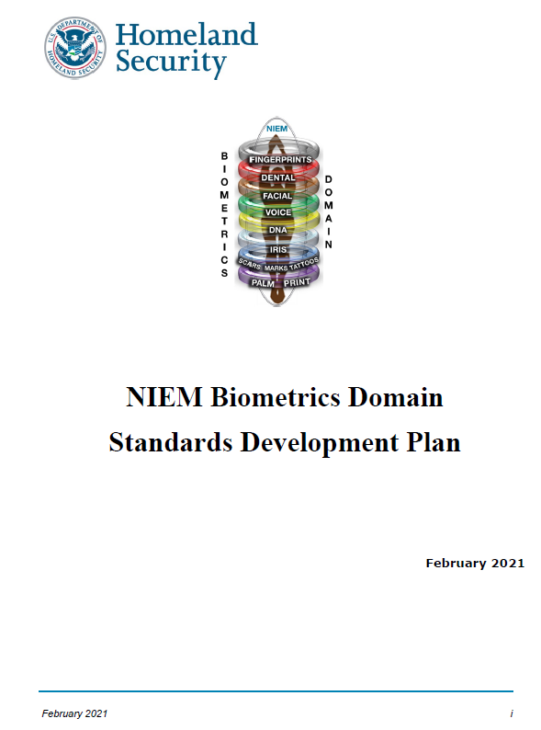
“Biometrics” Domain Update
Domain Steward & Stakeholders: (AD John M Boyd - Chair Biometrics Domain/DHS OBIM)
The NBD Team worked with the NIEM Management Office (NMO) to launch a NBD GitHub site to provide domain documentation to the NIEM community. https://niem.github.io/community/biometrics/
NBD Standards Development Plan
NBD Governance Process Plan
NBD Enterprise - Level Data Standards Execution Plan
NBD Domain Management Plan
How to Guide for Creating NIEM Biometric Exchanges
2021 Highlights
We provide quarterly biometrics newsletters for NBD Members.
We maintain & update the member list.
The NBD will continue the outreach to the biometrics community through development of domain documentation and newsletters.
The NBD Team will keep the GitHub site up to date with new information, activities, and updates to keep the community posted.
2022 Objectives
Please let us know if anyone is interested in NBD membership. We can be contacted via: OBIMFuturesIdentityNIEM@obim.dhs.gov
We would appreciate hearing success stories from other domains for engaging members.
Recommendations

Slide 14
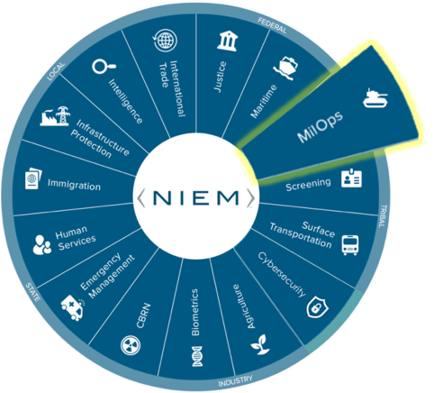
NBAC Annual Meeting
MilOps
DOMAIN UPDATES

Slide 15
MilOps Domain Update
Domain Steward & Stakeholders: Mr. Adrian Francis, Ms. Beth Smalley; DoD Joint Staff J6
Description
2021 Highlights: Describe your NIEM domain accomplishments, activities, best practices 2022 Objectives: Describe your NIEM domain goals and plans for next year NIEM Recommendations: Describe how NIEM should evolve to the “next level”
2021 Highlights
2022 Objectives
NIEM Recommendations
Added 485 JNKE IEPD cyber-related data objects to the model
Completing USMTF conversion to NIEM; will result in 1000s of elements and types for MilOps data model, 325 IEPDs
Migrated MOMS restricted content tools (SSGT, ConTesA) from Virtual Machine to Docker containers
Demonstrated additional NCDF capabilities at CWIX 2021
Submitted NCDF as a NATO STANAG (5653), integrating into FMN Spiral 5
Supporting VA and DMDC IEPD development for DD-214. Additional IEPDs planned.
Showcase improved NCDF capabilities in CWIX 2022
Add USMTF content to data model, publish USMTF IEPDs
Continue to support VA and DMDC IEPD development
Increased adoption of NIEM:
Counter Improvised Explosive Device (C-IED) JPO
JADC2 enterprise stakeholders
Army enterprise
Universal Command & Control (UC2)
Multi-X Security (MXS)
Defense Incident-Based Reporting System (DIBRS)
Engage newly assigned DoD and Federal Agency Chief Data Officers (CDOs)
Continue to collaborate with US and Coalition Executives on enterprise data efforts (e.g. JADC2, Open Data Act, UC2, etc.)
Improve user-friendly tools for browsing NIEM
Mature NIEM JSON tools and training
Provide end-to-end IEPD Lifecycle tool capability to trace information exchange requirements from scenario planning architecture artifacts with automated mapping and extract transform load (ETL) services
Notes:
Acronyms/Definitions:
ConTesA: Warrior Interoperability Exercise
DD 214: Certificate of Release or Discharge from Active Duty
DMDC: Defense Manpower Data Center
Docker container: A Docker container image is a lightweight, standalone, executable package of software that includes everything needed to run an application: code, runtime, system tools, system libraries and settings.
FMN: Federated Mission Networking
JADC2: Joint All Domain Command and Control
JNKE: Joint Non-Kinetic Effectiveness
JSON: Java Script Object Notation. JSON is a lightweight format for storing and transporting data JSON is often used when data is sent from a server to a web page JSON is "self-describing" and easy to understand
IEPD: Information Exchange Package Documentation
MOMS: Military Operations Mission Specific restricted content (Distribution Statement C and D) release
MXS: The Multi-X (Multi-Level, Multi-Compartment, Multi-Nation) Security (MXS) effort seeks to develop a security data labeling model, standard, software development kit (SDK), and unclassified cloud-hosted prototype demonstrating the utility of the MXS architecture. This will help lower the bar for third party software developers to quickly create next-generation, cloud-hosted applications with requirements for tracking data and users at multiple classifications and compartments for the SAP community.
NCDF: NATO Core Data Framework
NIEM: National Information Exchange Model
SSGT: Schema Subset Generation Tool
STANAG: Standardization Agreement
USMTF: United States Message Text Format
VA: Veterans Affairs

Slide 16
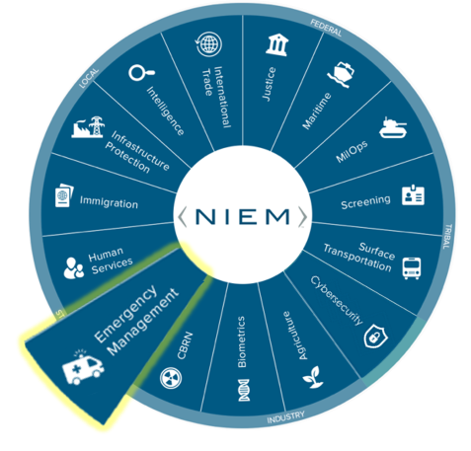
NBAC Annual Meeting
EMERGENCY MANAGEMENT
DOMAIN UPDATES

Slide 17
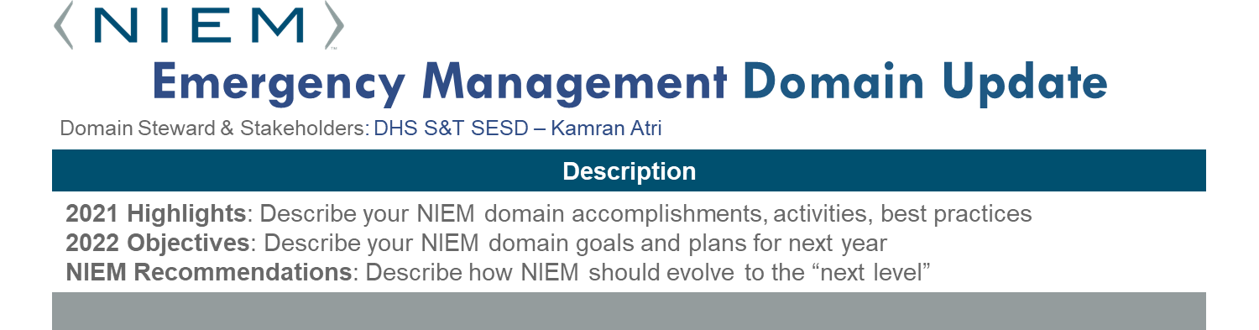
2021 Highlights
2022 Objectives
NIEM Recommendations
the DHS Science and Technology Directorate (S&T), Office of Science and Engineering (OSE), Systems Engineering and Standards Division (SESD) is not the Steward – in progress
Supported FEMA Data Exchanges Development from different FEMA offices
Outreach sessions to FEMA and other key stakeholders
Identified new attributes and contributed to NIEM Release (5.0)
Supported DHS Acting CDO with State of As-Is and suggestions on next steps
Attended justification meetings and or provided talking points for different DHS FEMA offices in using NIEM
Continue support NIEM Releases
Continue supporting DHS S&T and FEMA in developing new NIEM Data Standardized attributes
Plan and conduct quarterly EM Domain Internal training sessions
Customized Internal IEPD processes to better help implementation teams
Provide more support to SLTT organizations
Continue engaging NBAC and NTAC and NIEM PMO
Develop self guided training videos or metrical.

Slide 18
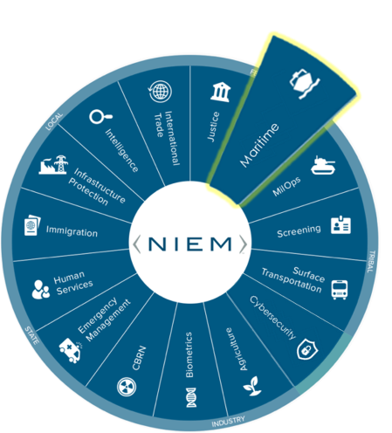
NBAC Annual Meeting
Maritime
DOMAIN UPDATES

Slide 19
Maritime Domain Update
Domain Steward & Stakeholders: Navy Information Warfare, Office of Naval Intelligence
Description
2021 Highlights: Explore opportunities to use NIEM 2022 Objectives: continue exploration and participate in `best practices’ activities NIEM Recommendations: Widely distribute practical standards (a.k.a. de facto best practices)
2021 Highlights
2022 Objectives
NIEM Recommendations
Conducted the 03-15AUG LSE21 that tested "war-fighting concepts that are not fully refined," across 17 time zones with 30+ live, 50+ virtual / constructive units.
Jupiter (Advana) 2.0 dashboards demonstrated better ability to access, correlate, visualize and model data in various forms throughout the DoN.
Continued investments in network modernizations and PED improvements.
Publishing SNI 5000.36B establishing guiderails for strategic use of data
Leverage afloat opportunities to improve associated management, automations, monitoring and interoperations. And derive inferences and insights to support timely and accurate decision making.
“Plug into JADC2” to develop the networks, infrastructure, data architecture, tools, and analytics” to support Distributed Maritime Operations.
Publish SECNAVINST 5000.36B
Maximize the use of de-facto best practices (e.g. NIEM-M “lite”) to expand participation and gain insights from data exposure via machine-to-machine interfaces.
Incorporate more live, virtual and constructed interoperability experiments.
Leverage emerging capabilities against legacy systems to maximize benefit indicators (More best practices using whatever works works).

Slide 20
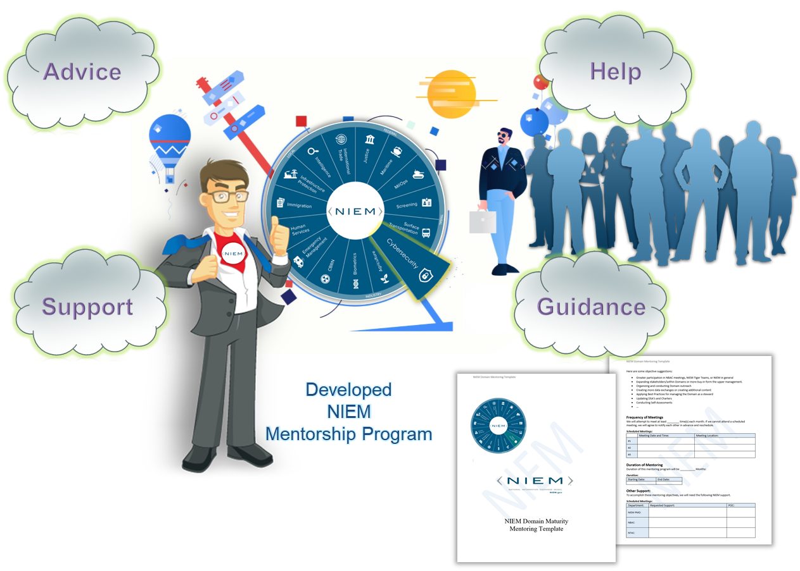
1
Domain Mentoring Program
17

Slide 21
NTAC Updates
NTAC Annual F2f
10-12 August 2021

Slide 22
NTAC Outbrief (1 of 2)
NIEM 6 architecture – potential changes
Changes for simplicity and consistency
Metadata
Ordered properties
Adopt XML Schema 1.1?
Life after metamodel tools
NIEM as a standard
NTAC consensus: We like OASIS Open Project
NBAC
Heard about NBAC upcoming plans and needs
Help with internationalization use cases

Slide 23
NTAC Outbrief (2 of 2)
Metamodel
Simplifications!
Separate model instance from technology-specific configuration
Tool status; goals and metamodel refinement
Message specification rules and conventions
Consensus on approach, nature of content
Developing document outline, work plan

Slide 24
NBAC provided Reqs during NTAC F2F 2021:
NTAC asked for NBAC to provide new business needs and features. Some topics that was discussed:
Activities to support the NIEM Standard
JSON development tools and or maturing NIEM and JSON
IoT, AI, advanced technology implementation
ConTesA (Lookup tool to help make older exchanges conformant with rationalized or newer versions of NIEM) – is it user-friendly?
XML, XML Schema, JSON done… what’s next? Harmonization between XML and JSON
Best approach in creating an internal ring to the existing NIEM ring (Core, Domains, International)...
Language conversion (Spanish, French....) – “defense/defence”, “colour/color”
Impact on NIEM/JSON implementation in using NIEM Core and Code ISO-639-3 (i.e. the size of language code table exceeds the possible enumerated value)
Defining API 3.0 that produces a valid NIEM XML payload and JSON payload
The code generators that produce the Java, ASP .Net, or other languages don’t always generate the expected XML annotations. Java is the only language so far we have been able to confirm that it does generate the annotations for most of the definitions.

Slide 25

New NIEM Domains

Slide 26
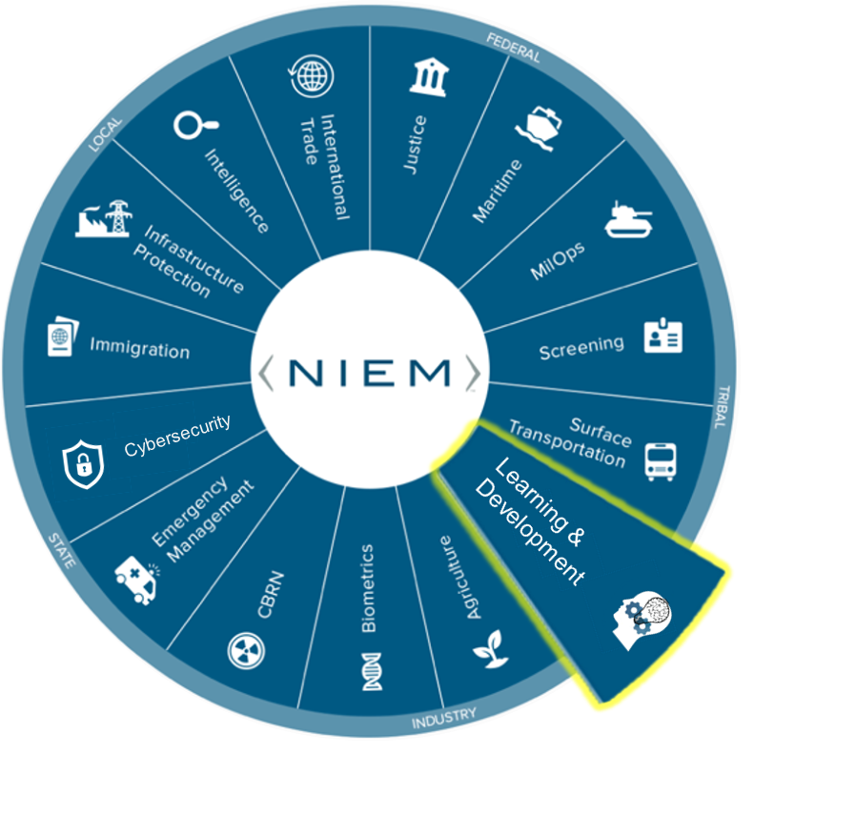
NBAC Annual Meeting
Learning and Development Domain
DOMAIN UPDATES

Slide 28
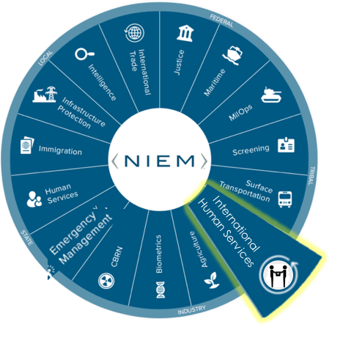

New NIEM International Human Services Domain

Slide 29


About Employment and Social Development Canada
Employment and Social Development Canada (ESDC) works to improve the standard of living and quality of life for all Canadians.
With over 27000 public servants, ESDC is the second largest department (information based on open government data 2020 numbers).
ESDC provide service that benefits Canadians through different life events in these three areas
Employment, Workforce Development and Disability Inclusion
Employment Insurance
Training
Funding programs
Families, Children and Social Development
Public pensions
Family benefits
Disability benefits
Housing benefits
Education
Labour
Find a job
Workplace standards
NOTE: Information is extrapolated form publicly available information here.

Slide 30
International Human Services Domain
The Need For IHS
Employment and Social Development Canada (ESDC) has subject matter and business experts in the area of service delivery to citizens
NIEM’s and Human Services have rich data model, however they do not cover the needs of international partners such as Canada
Employment and Social Development Canada (ESDC), as a steward and leader, would like to bridge this gap
The diverse programs and services ESDC is responsible for makes it the ideal candidate to be the steward of ISH domain
ESDC has already been using NIEM and developing it’s own extension schema since 2017
ESDC has a large benefit delivery modernization project which requires additional exchanges. The work that ESDC is embarking on will enrich the data model that is used by the NIEM community
ESDC is working to take NIEM to the next step by defining the steps required for data exchange using NIEM in a microservices architecture which implements Contract First approach when developing Application Programming Interface (API)

Slide 31
Value Proposition
International Human Services COI
Enhance HIS to support the international human services data needs by engaging with stakeholders
Promotes community-based agreement on data element names and definitions
Provides a framework for information exchange specifications with guide on how to define NIEM-conformant Representational State Transfer (REST) Application Program Interface (API)
Improves interoperability – making data visible, accessible, and understandable enterprise-wide
NIEM Community
Increases use of a common and standard data and information sharing model for international human services
Using NIEM increases interoperability within ESDC and other international organizations including federal, state, local, and tribal entities
Engage and increase the application developer community involvement with NIEM
Reduces development and maintenance costs for any entity seeking information sharing links
IHS Domain broadens accessibility of information to the NIEM international community

Slide 32
NIEM IHS tentative Org-chart
Proposed Organization Chart International Human Services Domain
TBD Co-Chair TBD
Mr. Michel Savoie
Steward Chair
TBD Co-Chair TBD
TBD
Facilitator
Volunteer Tech. Support TBD
Volunteer Com. Support TBD
Members Gen. Support TBD

Slide 33
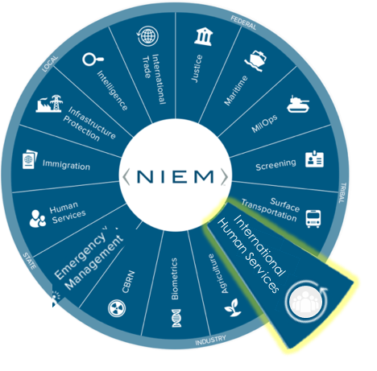
NBAC Annual Meeting
INTERNATIONAL HUMAN SERVICES
DOMAIN UPDATES

Slide 34
International Human Services Domain Update
Domain Steward & Stakeholders: Michel Savoie, Employment and Social Development Canada (ESDC)
Description
2021 Highlights: Describe your NIEM domain accomplishments, activities, best practices 2022 Objectives: Describe your NIEM domain goals and plans for next year NIEM Recommendations: Describe how NIEM should evolve to the “next level”
2021 Highlights
2022 Objectives
NIEM Recommendations
Discussion on establishment of IHS as prospective domain
Shared potential candidates for additions to NIEM core with NMO
Shared ESDC internal team best practice and process with NMO
Expand the IHS by enriching the data model with new elements based on ESDC projects
Inclusion of new attributes to support the international community of NIEM based on CIO request and engagement
Having a transformation /translation tool to convert NIEM XSD to JSON schema or Open API YAML will encourage the developer community to be more open to using NIEM based data standardization.

Slide 35
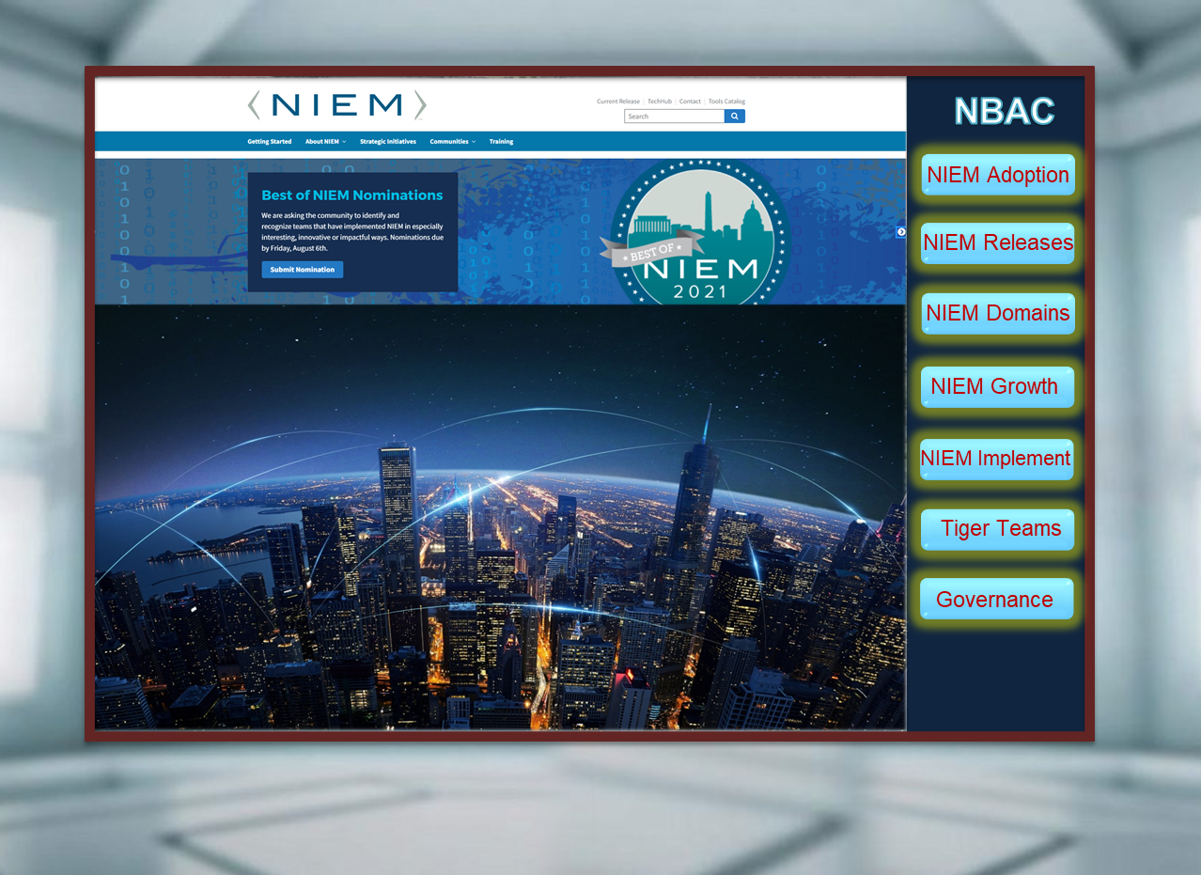
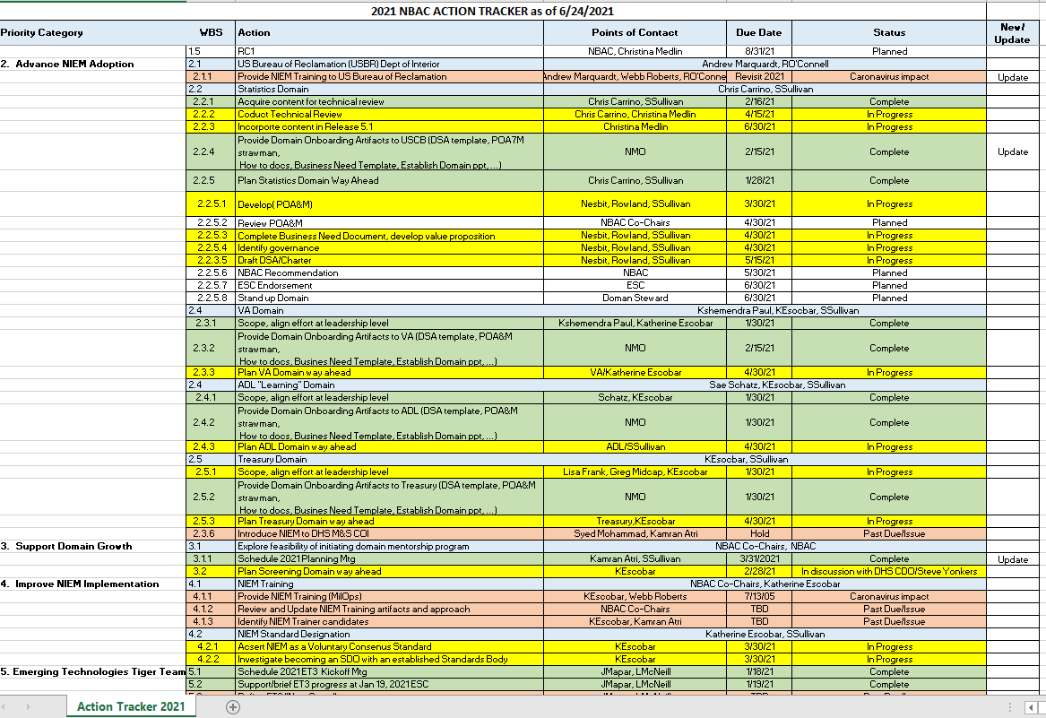


NBAC 2022 Priorities / Work Plan
NBAC Action
Tracker
Onboarding / Maturing Domains
Mentoring Program
Leveraging Tiger Teams
Internationalization
State, Local, Tribal, Territorial
NIEM as a Standard
Training Offerings
…
Continue adding/maturing NIEM Domains Content …
Onboarding
VA Domain

Slide 36
2021/2022 Work Plan (Cont.)
Future NIEM Release Plan … 5.2
… Census (Statics Domain), ADL (L&D Domain), Biometrics Domain, Cyber Domain, EM Domain, MilOps Domain
NIEM Documentation Review (Governance and Process) as we move to tag NIEM as a Data Standard Organization
PMO, NBAC or NTAC Charters and Governance Documents
NIEM Openness / Transparency
Are there any Barriers to Participation
What are NIEM Voting and Decision-making process
What are the NIEM Membership Requirements (for Gov and non-Gov organizations)
What are the Technical Qualifications for joining NIEM
What are NIEM Objection process in accessing documents or Evaluating new content
What is NIEM Appeal process for Domain On-boarding, Standard development, or Conflict Resolution
What are NIEM Terms and Conditions regarding Privacy, Patent, Security, Antitrust, Adjudication…
What are NIEM Established and Enforced Processes: Proxy voting, Technical Assistance (i.e. Help desk), Active or Inactive status of standard, Release (emergency or normal)

Slide 37
2021/2022 Work Plan (Cont.)
Internationalization
Language
Invigorating the tiger team (Meetings, charter…)
Which partner do we cultivate next
Tiger team
Way ahead for ETS
NIEM Adoption 2022
VA … USCB …Others, as we are actively exploring opportunity areas
NIEM Training
What would be the NBAC role?
Mentoring Program
Next Steps

Slide 38
2021/2022 Work Plan (Cont.)
2020 Annual Report
Should the NBAC Have a Github Site
How best to take advantage of Social Media

Slide 39
Sharing and collaboration
It’s your model/it’s our model/it’s their model.
In a modern, digitally-enabled world where the risk of NOT interoperating remains high, Interoperability begins with all of us.

Slide 40

NIEM Plays a Key Role in:
Designating an Organization as a “ Data Driven Organization ”.
Organizations that must Consume, Access, Manipulate, Manage, Analyze, Standardize, Share and Distribute all Available Data from Existing or New Potential Data Sources.
Data Architecture, Data Management and Data Engineering, the Key Components of any IT Modernization Life Cycle.

Slide 41



Questions?
Enabling Connected Future Now
Thomas Krul
Kamran Atri
Stephen M. Sullivan
thomas.krul@canada.ca
katri@A4SAFE.COM
Stephen.m.sullivan14.ctr@mail.mil
Sullivan_Stephen@bah.com
NBAC Co-Chairs
NBAC Co-Chairs
NBAC Secretariat –NIM PMO

